Slide 1
PROJECT PRESENTATION
IOT-BASED HOME AUTOMATION
Group Members
Gaurav Singh
gauravsinghmmmut53@gmail.com
N V A L Vara Prasad
nukala.ece2021@vietsp.com
Asogwa Emmanuel
asogwaemmanuel36@gmail.com
Medapati.Bhagyasri
bhagyasrimedapati2@gmail.com

Slide 2
PART I
Compiled and Presented by:
Gaurav Singh
gauravsinghmmmut53@gmail.com

Slide 3
TOPICS LEARNT DURING INTERNSHIP
C Programming
1.1 Variable
1.2 Operators
1.3 Keyword
1.4 Concepts Arrays
1.5 Pointers
1.6 Function
1.7 Storage Classes Pre-processor directives and header files

Slide 4
General Aspect of ‘C’
C was originally developed in the 1970s, by Dennis Ritchie at Bell Telephone Laboratories, Inc.
C is a High level , general –purpose structured programming language. Instructions of C consists of terms that are very closely same to algebraic expressions, consisting of certain English keywords such as if, else, for ,do and while
C contains certain additional features that allows it to be used at a lower level , acting as bridge between machine language and the high level languages.
This allows C to be used for system programming as well as for applications programming

Slide 5
Variables
A variable is nothing but a name given to a storage area that our programs can manipulate. Each variable in C has a specific type, which determines the size and layout of the variable's memory; the range of values that can be stored within that memory; and the set of operations that can be applied to the variable
There are following basic variable types −
Type Description
char Typically size of char variable is 1 byte.
int Typically size of int variable is 2 byte.
float Size of float variable is 4 byte.
double A double variable is of size 8 bytes

Slide 6
Operators An operator is a symbol which operates on a value or a variable. For example: + is an operator to perform addition.
Operator Meaning of Operator
+ Addition or unary plus
- Subtraction or unary minus
* Multiplication
/ Division
% Modulo (remainder)

Slide 7
C Relational Operators
A relational operator checks the relationship between two operands. If the relation is true, it returns 1; if the relation is false, it returns value 0.
Relational operators are used in decision making and loops.
Operator Meaning of Operator Example
== Equal to 5 == 3 returns 0
> Greater than 5 > 3 returns 1
< Less than 5 < 3 returns 0
!= Not equal to 5 != 3 returns 1
>= Greater than or equal to 5 >= 3 returns 1
<= Less than or equal to 5 <= 3 return 0

Slide 8
Keywords
Keywords are nothing but system defined identifiers.
Keywords are reserved words of the language.
They have specific meaning in the language and cannot be used by the programmer as variable or constant names
C is case sensitive, it means these must be used as it is
32 Keywords in C Programming
auto | double | int | struct
break | else | long | switch
case | enum | register | typedef
char | extern | return | union
const | float | short | unsigned
continue | for | signed | void
default | goto | sizeof | volatile
do | if | static | while

Slide 9
ARRAY
What is Array in C?
An array in C is a fixed-size collection of similar data items stored in contiguous memory locations.
It can be used to store the collection of primitive data types such as int, char, float, etc., and also derived and user-defined data types such as pointers, structures, etc.
Syntax int arr[5];

Slide 10
POINTER
What is a Pointer in C?
A pointer is a derived data type in C that can store the address of other variables or a memory. We can access and manipulate the data stored in that memory location using pointers.
Syntax-
Datatpye *pinter_name;

Slide 11
FUNCTION
What is a function in C?
Functions are sets of statements that take inputs, perform some operations, and produce results. The operation of a function occurs only when it is called.
Rather than writing the same code for different inputs repeatedly, we can call the function instead of writing the same code over and over again.
Syntax
int sum(int a,int b);

Slide 12
PART II – Arduino
Compiled and Presented by:
N V A L Vara Prasad
nukala.ece2021@vietsp.com

Slide 13
Introduction to arduino

Slide 14
Arduino
Arduino is the go-to gear for artists, hobbyists, students, and anyone with a gadgetry dream.
Arduino rose out of another formidable challenge: how to teach students to create electronics, fast.
With Arduino, you can control almost everything around you be it simple LED or giant Robots.

Slide 15
Arduino
Basically Arduino is Microcontroller.
Microcontroller is microprocessor with memory, RAM and some other peripheral connected with it.
The Arduino Uno is a microcontroller board based on the ATmega328 . The ATmega328 has Flash memory of 32 KB (with 0.5 KB used for the bootloader). It also has 2 KB of SRAM and 1 KB of EEPROM
Notes:
Flash- Where program is stored.
SRAM-Static Random Access Memory ( sketch creates and manipulates variables when it runs )
EEPROM- Electrically Erasable Programmable Read-Only Memory ( memory whose values are kept when the board is turned off )

Slide 16
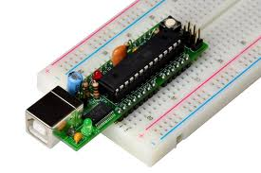
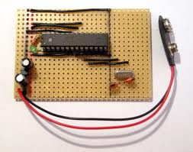
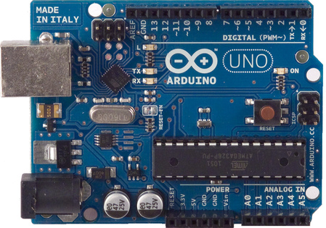
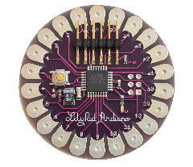
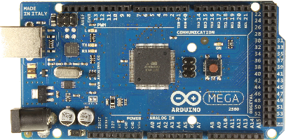
Different types of Arduino
Boarduino Kit
Arduino LilyPad
DIY Arduino
Arduino Uno
Arduino Mega 2560

Slide 17
Arduino uno
What does it have?
14 Digital In/Out pins (6 can be used as PWM)
6 Analog Inputs
A USB Connection
A Power Jack
Reset Button
On-board LED
SCL/SDA pins (Serial Clock/ Serial Data pins)
In short, it contains everything needed to support the microcontroller; simply connect it to a computer with a USB cable or power it with a AC-to-DC adapter or battery to get started.

Slide 18
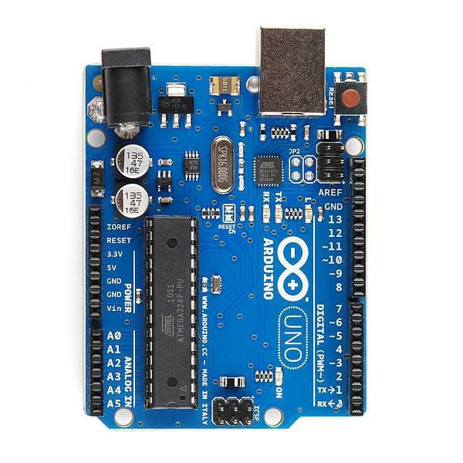
USB
(to Computer)
PWR IN
RESET
SCL\SDA
(I2C Bus)
POWER
5V / 3.3V / GND
Digital I\O
PWM(3, 5, 6, 9, 10, 11)
Analog INPUTS

Slide 19
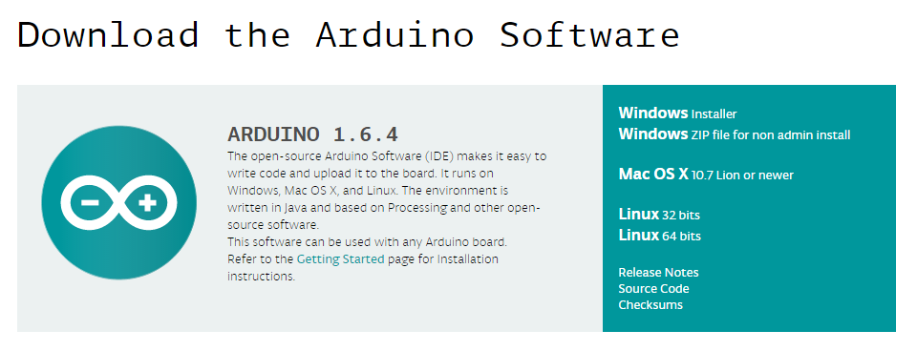
How to code in arduino
You need to download Arduino IDE (Integrated Development Environment).
Arduino IDE is available for all Mac, Windows.and Linux.

Slide 20
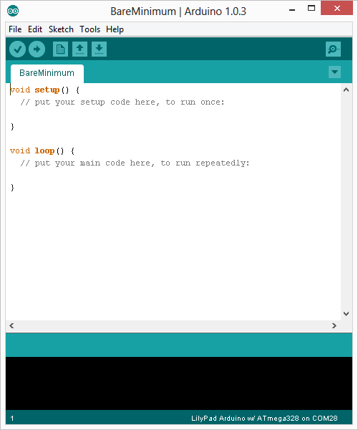
How to code in arduino
Once you have downloaded and installed/extracted the folder, you can directly run Arduino.exe, which will take you to its IDE.
The IDE will look like the shown screenshot.
error & status messages

Slide 21
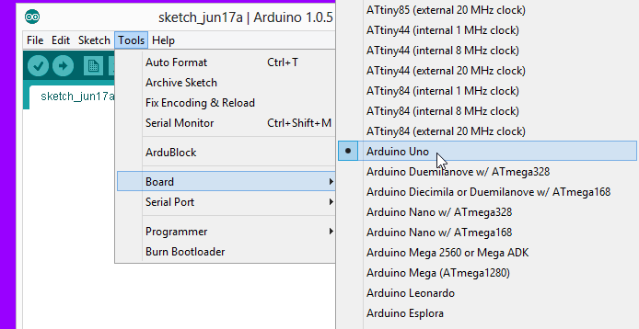
Program your arduino
Before you start programming, double check that correct board is selected under Tools → Board.
Now, you can start playing with Arduino.

Slide 22
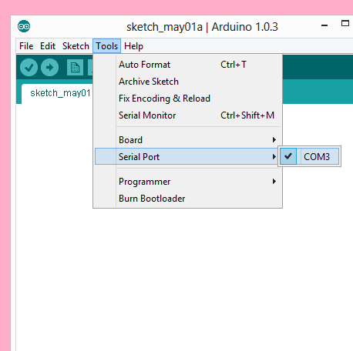
Program your arduino
The Arduino Uno can be programmed with the Arduino software. Select "Arduino Uno from the Tools > Board menu (according to the microcontroller on your board).
All the peripheral connected with Computers are using Serial Port.
You can check port for Arduino Uno in Device Manger.

Slide 23
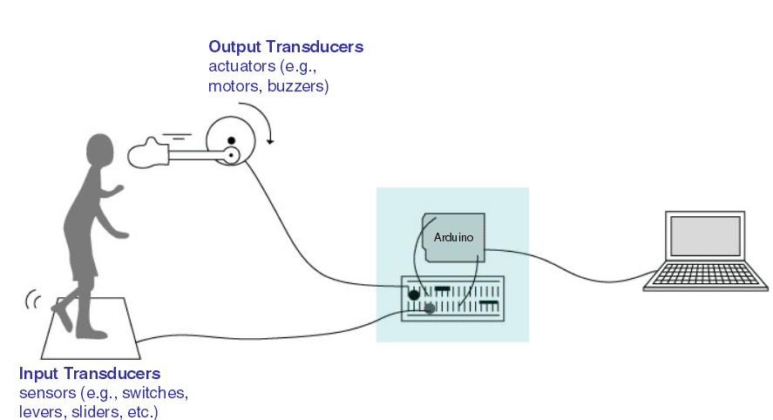
Input vs output

Slide 24
6 Major concepts
digitalWrite()
analogWrite()
digitalRead()
If (statements) / Boolean
analogRead
Serial Communication

Slide 25
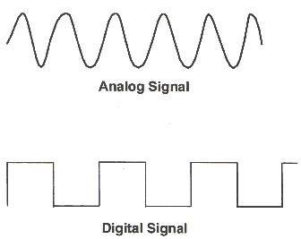
Analog vs digital
Microcontrollers are digital devices – ON or OFF. Also called – discrete.
Analog signals are anything that can be a full range of values.
5 V
5 V
0 V
0 V

Slide 26
Analog vs digital
Analog Sensors
Digital Sensors
Digital sensors are more straight forward than Analog.
No matter what the sensor there are only two settings: On and Off
Example, Push button, Switch
Sensors | Variables
Mic | soundVolume
Photoresistor | lightLevel
Potentiometer | dialPosition
Temp Sensor | temperature
Flex Sensor | bend
Accelerometer | tilt/acceleration

Slide 27
Serial communication
“Serial” because data is broken into bits, each sent one after another in a single wire.
Compiling turns your program into binary data (ones and zeros)
Uploading sends the bits through USB cable to the Arduino
The two LEDs near the USB connector blink when data is transmitted.
RX blinks when the Arduino is receiving data.
TX blinks when the Arduino is transmitting data

Slide 28
Let’s start coding

Slide 29
Project #1 led blink
digitalWrite()

Slide 30
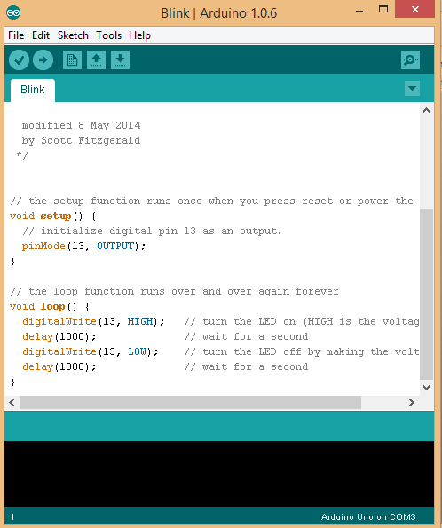
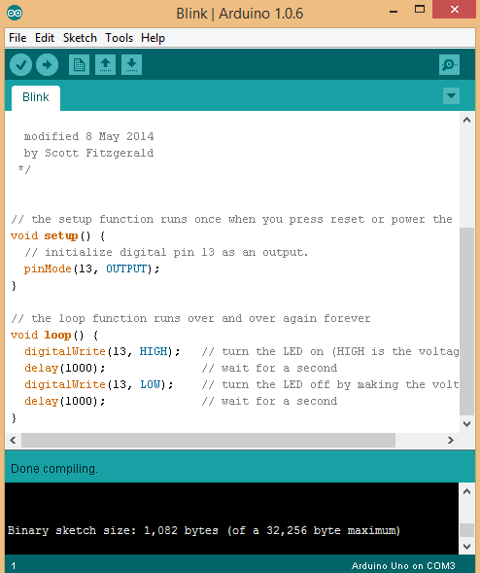
Upload
Compile
Status Message

Slide 31
Thank you

Slide 32

PART III – IoT and Project Requirements
Compiled and Presented by:
Medapati. Bhagyasri
bhagyasrimedapati2@gmail.com

Slide 33
PROJECT
IOT BASED HOME AUTOMATION

Slide 34

CONTENTS
TOPICS LEARNT DURING INTERNSHIP
WHAT IS IOT?
IOT ARCHITECTURE
WHAT IS EMBEDDED SYSTEM
PROJECT REQUIREMENTS
REQUIREMENTS
SCREENSHOTS
CONCLUSION
IMPLEMENTATION

Slide 35

TOPICS LEARNT DURING INTERNSHIP
C Programming
Keywords
Basic data types --- int, char, float, double, void Operators
Conditional constructs and Looping concepts Arrays
Pointers Functions --- Built-in and User defined functions
Storage Classes Pre-processor directives and header files

Slide 36
TOPICS LEARNT DURING INTERNSHIP
C++ Programming
OOP concepts
Introduction to IoT Definition of IoT IoT Architecture
Introduction to Embedded systems Definition Types of Embedded systems Components of Embedded systems
Peripherals LED
Arduino Uno
CLCD -- 14 pins description of CLCD
ADC --- Use of ADC in Arduino

Slide 37
WHAT IS IOT?
The Internet of Things (IoT) is the network of physical objects that contain embedded technology to communicate and sense or interact with their internal states or the external environment.
These devices range from ordinary household objects to sophisticated industrial tools. With more than 7 billion connected loT devices today, experts are expecting this number to grow to 10 billion by 2020 and 22 billion by 2025.
By means of low-cost computing, the cloud, big data, analytics, and mobile technologies, physical things can share and collect data with minimal human intervention. In this hyper connected world, digital systems can record, monitor, and adjust each interaction between connected things. The physical world meets the digital world-and they cooperate.

Slide 38

IOT Architecture

Slide 39
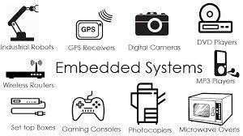
WHAT IS EMBEDDED SYSTEM?
Any combination of hardware and software which is intended to do a specific task can be called an Embedded System
It has 3 parts; software, firmware and hardware.
Unlike computers, embedded systems perform few specific limited tasks.
Embedded Devices have peripherals such as Serial Communication Interfaces (SCI), Synchronous Serial Communication Interface, Universal Serial Bus (USB), Multi Media Cards (SD cards, Compact Flash) etc.

Slide 40
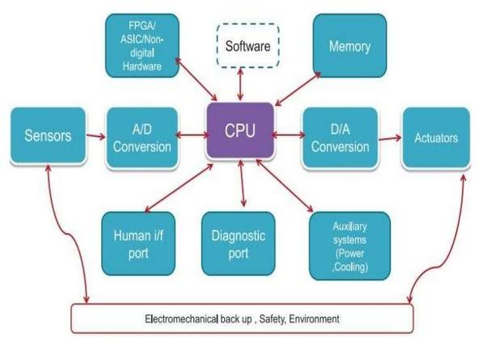
EMBEDDED SYSTEM

Slide 41
PROJECT REQUIREMENTS
Control garden lights on basis of sunlight intensity: Lesser the sunlight brighter the garden lights
Temperature system control: Switch heater and cooler ON or OFF remotely. Switch heater OFF automatically if temperature indoors exceeds 35' C.

Slide 42
REQUIREMENTS
HARDWARE REQUIREMENTS
_{ARDUINO UNO}
_{LCD HD44780}
_{LDR SENSOR}
TEMPERATURE SENSOR
SOFTWARE REQUIREMENTS
ARDUINO IDE : To code PICSIMLAB: For simulation
Blynk IOT app : Cloud server

Slide 43
ARDINO UNO
Arduino UNO is based on an ATmega328P microcontroller.
It is easy to use compared to other boards, such as the Arduino Mega board, etc. The board consists of digital and analog Input / Output pins (I/O), shields, and other circuits.
The Arduino UNO includes 6 analog pin inputs, 14 digital pins , a USB connector, a power jack, and an ICSP (In-Circuit Serial Programming) header.
It is programmed based on IDE, which stands for Integrated Development Environment. It can run on both online and offline platforms

Slide 44
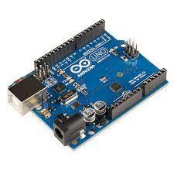

Slide 45
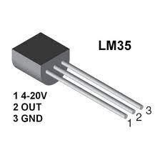
TEMPERATURE SENSOR
A Temperature sensor is an electronic device that measure the temperature of its environment and converts the input data into electronic data to record, monitor, or signal Temperature changes.

Slide 46
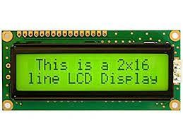
LCD HD44780
LCD HD44780 is dot-matrix liquid crystal display controller and
driver LSI displays alphanumeric and symbols .
It can be configured to drive a dot-matrix liquid crystal display under the control of a 4 or 8-bit microprocessor.

Slide 47
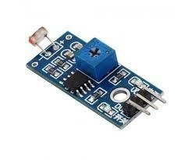
LDR SENSOR
An LDR is a component that has a (variable) resistance that changes with the light intensity that falls upon it. This allows them to be used in light sensing circuits .
The resistance of a Photo resistor decreases with increasing incident light intensity. In other words, it exhibits photoconductivity.

Slide 48
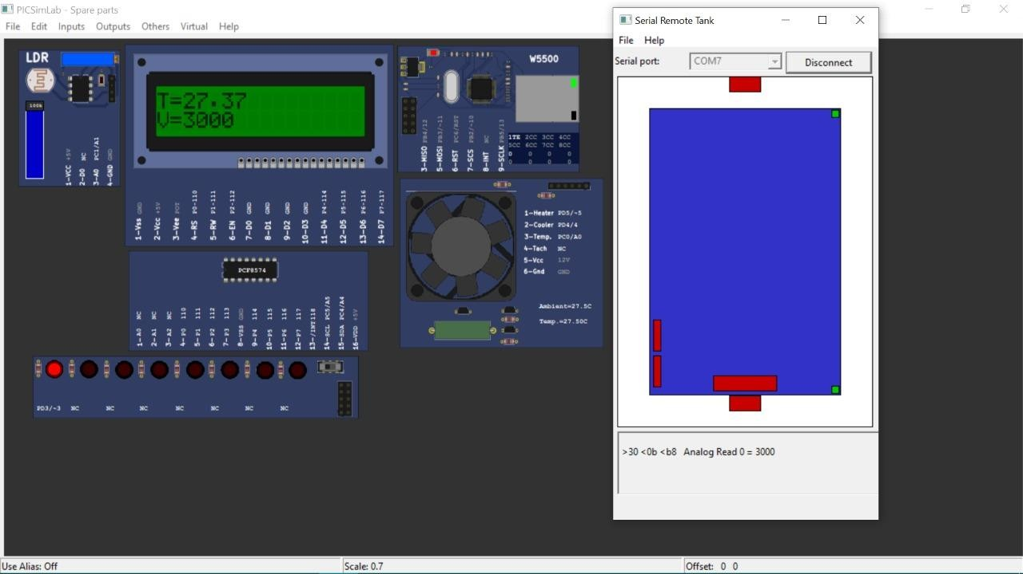
Step 1 :- When we load the hex file

Slide 49
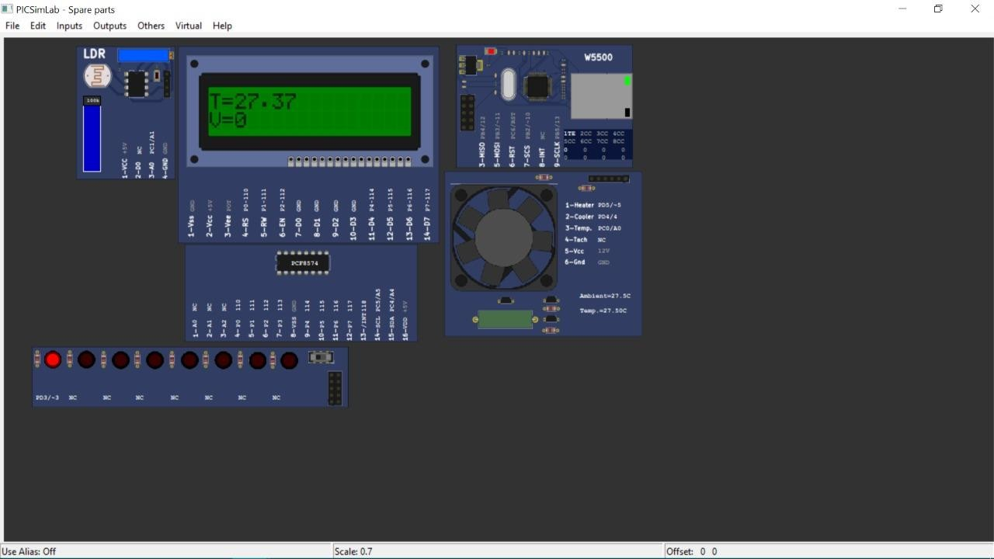
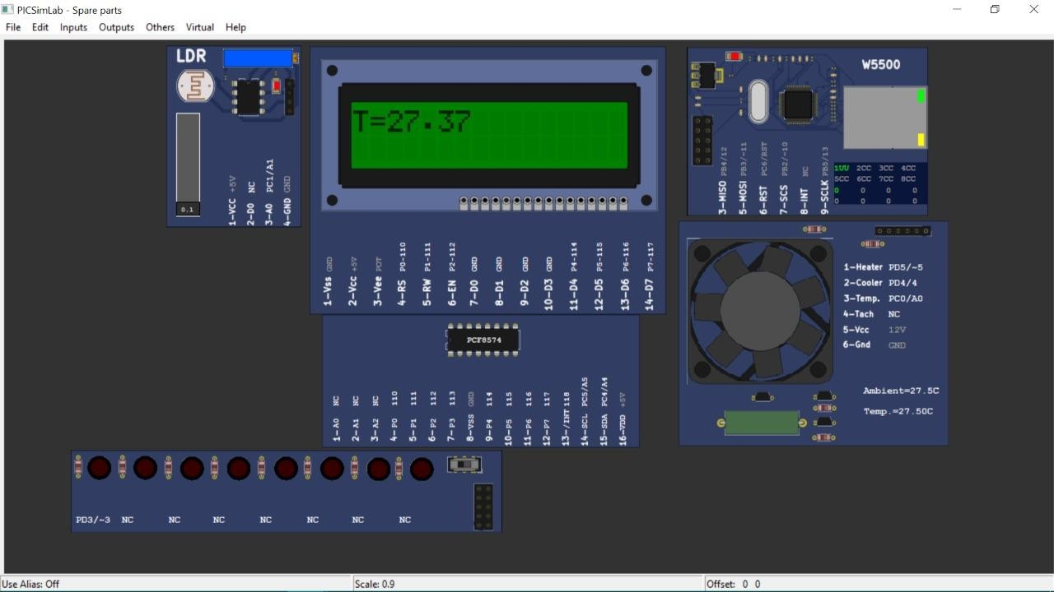
LDR is HIGH so LED is ON
LDR is LOW so LED is OFF

Slide 50

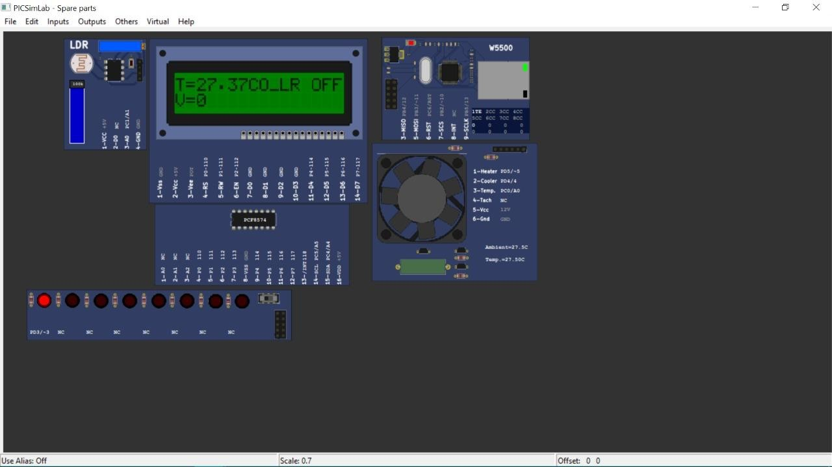
Cooler is ON
Cooler is OFF

Slide 51

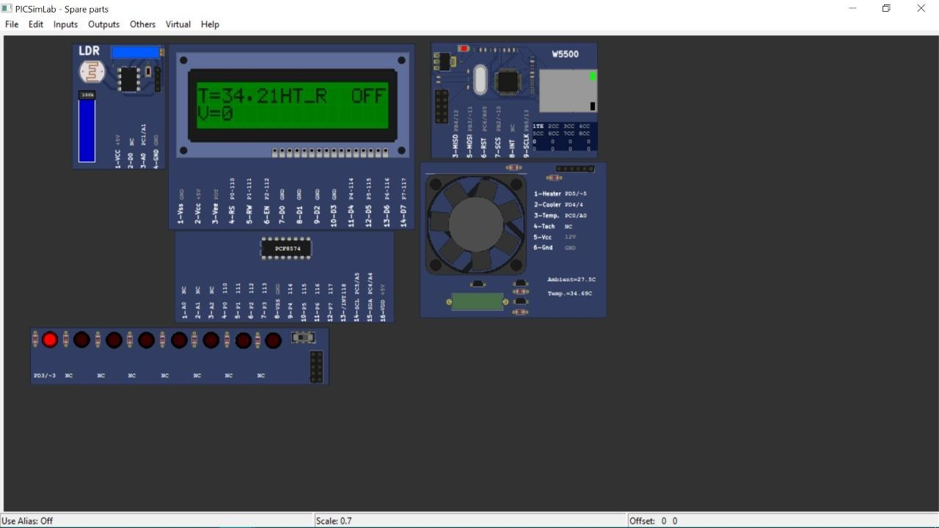
Heater is ON
Heater is OFF

Slide 52
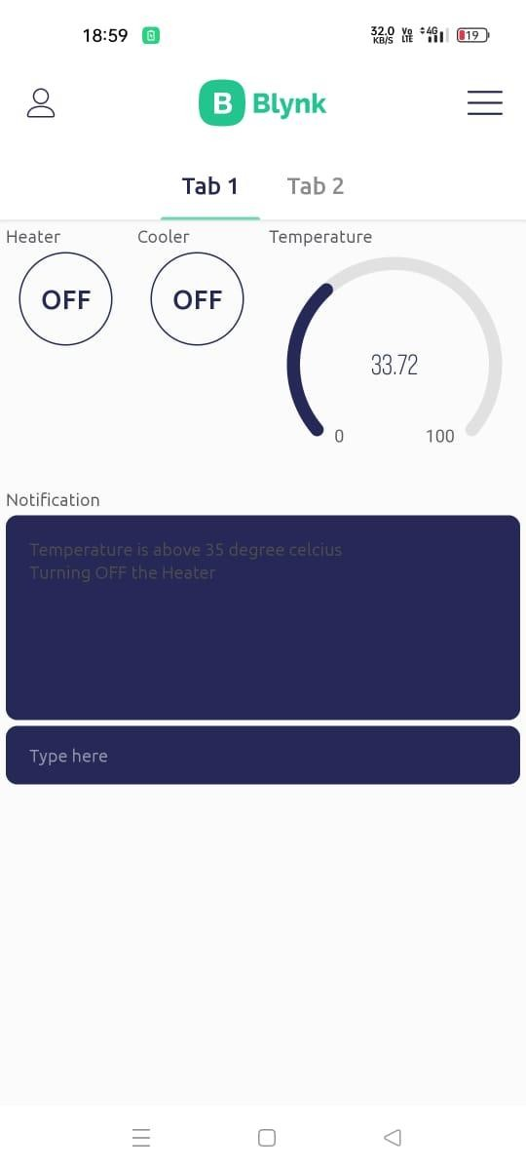
Notification of heater temperature

Slide 53
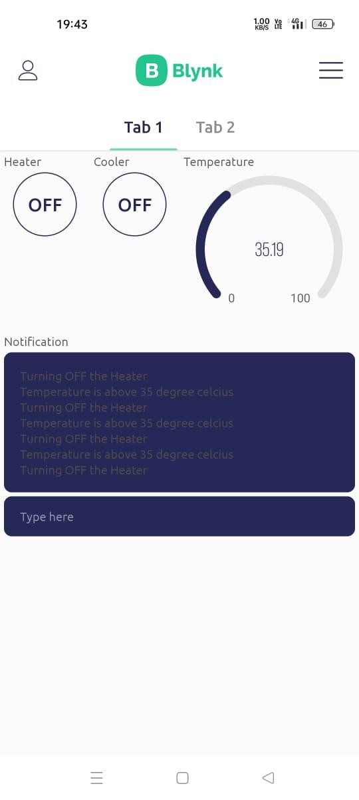
Heater will automatically turn OFF when temperature rises above 35

Slide 54
CONCLUSION
Using BLYNK lot application and Picsimlab simulator, simulated home automation, where LED, temperature system resembles Light, Heater, and Cooler in real time.
CLCD acts like a dashboard used for displaying the events, Widgets from Blynk Iot app like button widgets are used to control heater, cooler and LED's.
Gauge widgets to display the temperature.

Slide 55
PART IV – Implementation and Demo:
Asogwa Emmanuel
asogwaemmanuel36@gmail.com

Slide 56
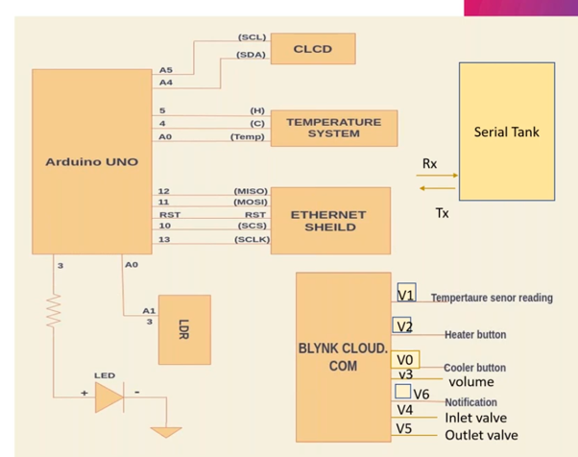
BLOCK DIAGRAM

Slide 57
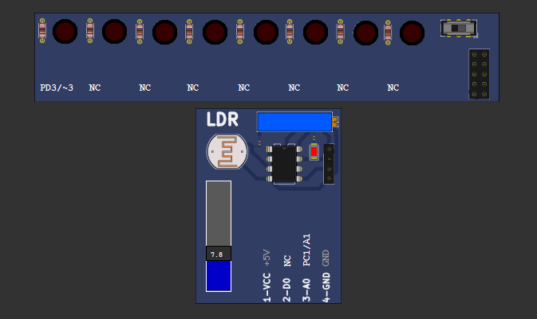
GARDEN LIGHTS CONTROL

Slide 58
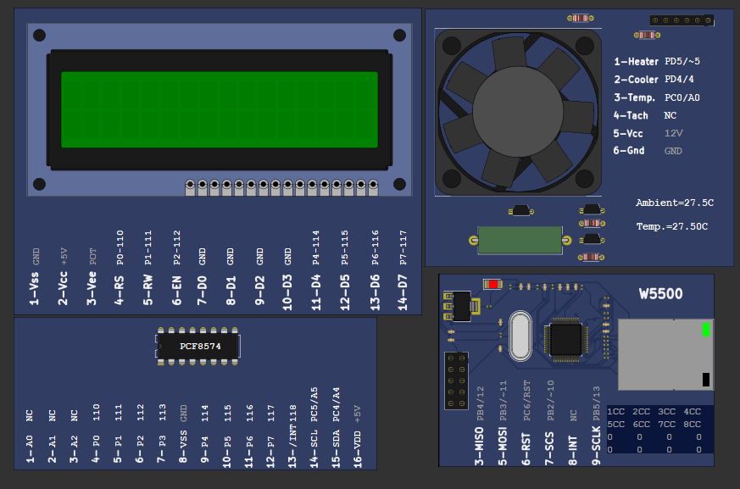
Temperature control

Slide 59
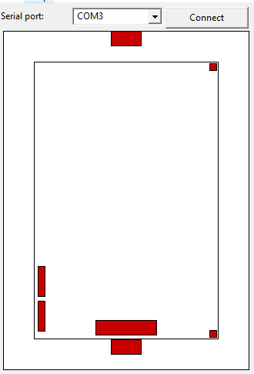
Serial tank control

Slide 60
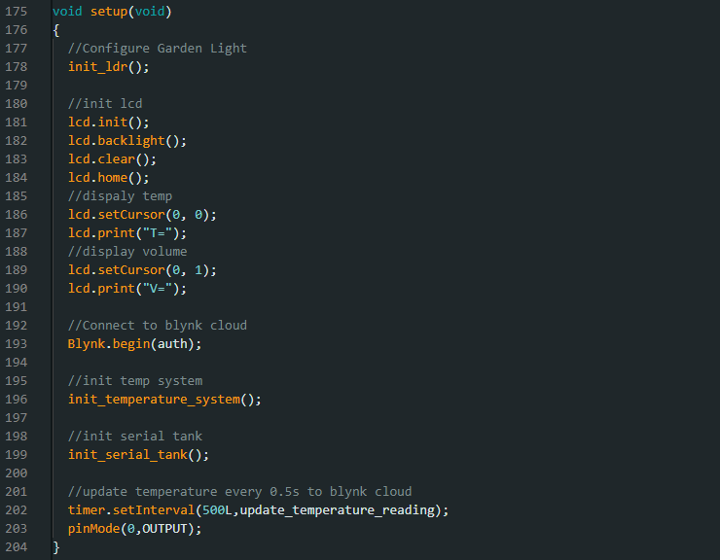
SETUP FUNCTION

Slide 61
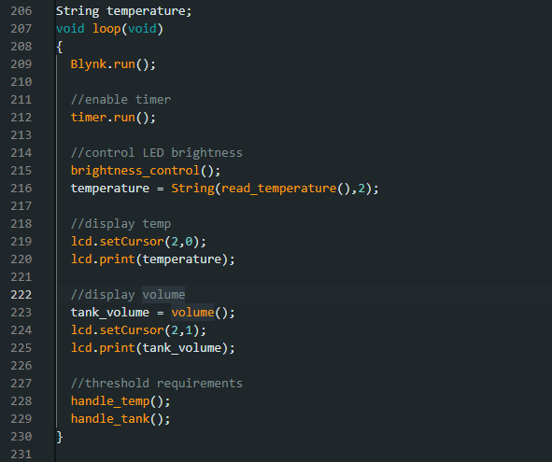
LOOP FUNCTION

Slide 62
OUTPUT

Slide 63
OUTPUT

Slide 64

CONCLUSION
The final result is a simulated Automated Home Project that can be remotely controlled and with a dashboard that displays its status

Slide 65

Thank you

